Slide 1

Linear Programming: Simplex Method
MTH 564 – Mathematical Modeling

Slide 2
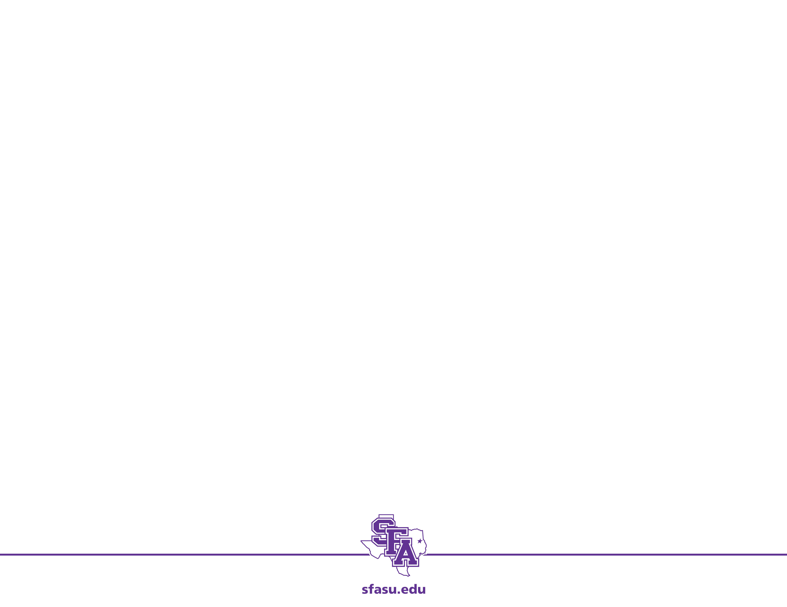
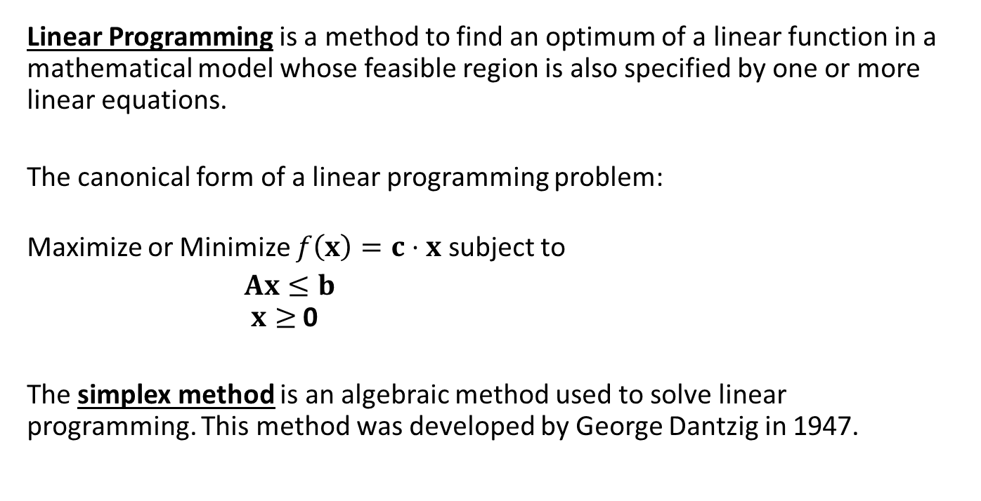
Linear Programming
Linear Programming is a method to find an optimum of a linear function in a mathematical model whose feasible region is also specified by one or more linear equations.
The canonical form of a linear programming problem:
Maximize or Minimize $f\left(x\right)=c⋅x$ subject to
$Ax≤b$ $x≥$ 0
The simplex method is an algebraic method used to solve linear programming. This method was developed by George Dantzig in 1947.

Slide 3
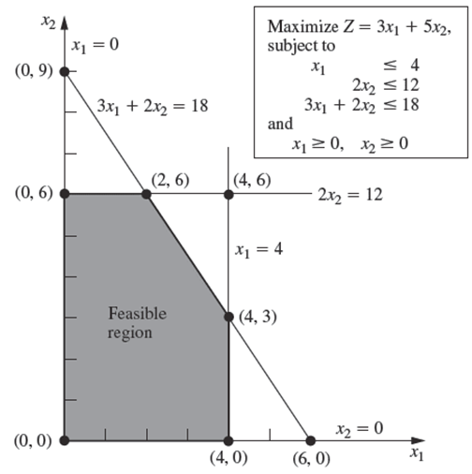
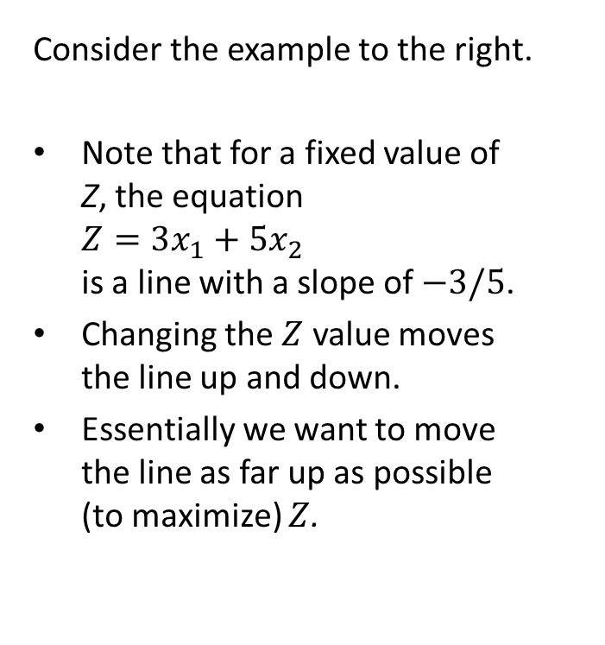
Simplex Method: Geometric Idea
Consider the example to the right.
Note that for a fixed value of Z, the equation $Z=3x_{1}+5x_{2}$ is a line with a slope of $−3/5$.
Changing the $Z$ value moves the line up and down.
Essentially we want to move the line as far up as possible (to maximize) $Z$.

Slide 4
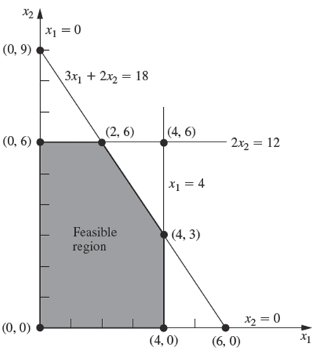
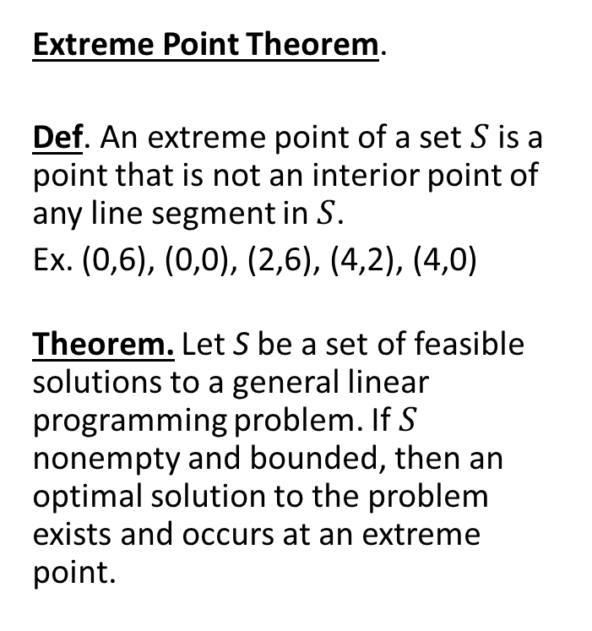
Simplex Method: Theory
Extreme Point Theorem.
Def. An extreme point of a set $S$ is a point that is not an interior point of any line segment in $S$.
Ex. (0,6), (0,0), (2,6), (4,2), (4,0)
Theorem. Let S be a set of feasible solutions to a general linear programming problem. If $S$ nonempty and bounded, then an optimal solution to the problem exists and occurs at an extreme point.

Slide 5
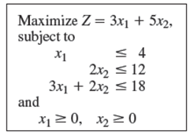
Simplex Method: Process
Part 1: Form the Simplex Tableau
Rewrite the equations adding slack variables to the inequalities and setting the objective function equal to 0. This is called the augmented form.
Z - 3x₁- 5x₂ = 0
x₁ + s₁ = 4
2x₂ + s₂ = 12
3x₁ +2x₂ + s₃ = 18
x₁ , x₂, s₁, s₂, s₃ ≥ 0
Put all the information in a table with the first row the name of each variable, each subsequent row holding the coefficients of the variables, with the last row holding the coefficients of the objective function.

Slide 6
Simplex Method: Form the Tableau
Part 1: Form the Simplex Tableau
From the augmented form is
Z - 3x₁- 5x₂ = 0
x₁ + s₁ = 4
2x₂ + s₂ = 12
3x₁ +2x₂ + s₃ = 18
x₁ , x₂, s₁, s₂, s₃ ≥ 0 we get the tableau
Basic | x₁ | x₂ | s₁ | s₂ | s₃ | RHS
s₁ | 1 | 0 | 1 | 0 | 0 | 4
s₂ | 0 | 2 | 0 | 1 | 0 | 12
s₃ | 3 | 2 | 0 | 0 | 1 | 18
Z | -3 | -5 | 0 | 0 | 0 | 0

Slide 7
Simplex Method: Find the Pivot
Part 2: Find the Pivot
Basic | x₁ | x₂ | s₁ | s₂ | s₃ | RHS
s₁ | 1 | 0 | 1 | 0 | 0 | 4
s₂ | 0 | 2 | 0 | 1 | 0 | 12
s₃ | 3 | 2 | 0 | 0 | 1 | 18
Z | -3 | -5 | 0 | 0 | 0 | 0
Basic | x₁ | x₂ | s₁ | s₂ | s₃ | RHS
s₁ | 1 | 0 | 1 | 0 | 0 | 4
s₂ | 0 | 2 | 0 | 1 | 0 | 12
s₃ | 3 | 2 | 0 | 0 | 1 | 18
Z | -3 | -5 | 0 | 0 | 0 | 0
Determine the entering variable by selecting the variable with the most negative in the last row. This column becomes the pivot column
therefore, the most negative is -5. consequently, x₂ is the entering variable. It is the variable that has the most impact on the objective function.

Slide 8
Simplex Method: Find the Pivot
Part 2: Find the Pivot
Basic | x₁ | x₂ | s₁ | s₂ | S₃ | RHS
s₁ | 1 | 0 | 1 | 0 | 0 | 4
s₂ | 0 | 2 | 0 | 1 | 0 | 12
s₃ | 3 | 2 | 0 | 0 | 1 | 18
Z | -3 | -5 | 0 | 0 | 0 | 0
Basic | x₁ | x₂ | s₁ | s₂ | s₃ | RHS | Ratio
s₁ | 1 | 0 | 1 | 0 | 0 | 4 | 4/0 DNE
s₂ | 0 | 2 | 0 | 1 | 0 | 12 | 12/2 =6
s₃ | 3 | 2 | 0 | 0 | 1 | 18 | 18/2=9
Z | -3 | -5 | 0 | 0 | 0 | 0
Based on the constraints find the maximum the entering variable is allowed to change.
The most x₂ can change by is 6. Thus s₂ becomes the leaving variable and it’s row is the pivot row with 2 as the pivot number. It is the variable that has the most impact on the objective function.

Slide 9
Simplex Method: Pivot
Part 3: Pivot
Basic | x₁ | x₂ | s₁ | s₂ | s₃ | RHS | Ratio
s₁ | 1 | 0 | 1 | 0 | 0 | 4 | 4/0 DNE
s₂ | 0 | 2 | 0 | 1 | 0 | 12 | 12/2 =6
s₃ | 3 | 2 | 0 | 0 | 1 | 18 | 18/2=9
Z | -3 | -5 | 0 | 0 | 0 | 0
Pivot around the highlighted 2.
Basically x₂ changes to 6 and we change all the other equations accordingly. That is, we remove x₂ from all other equations.

Slide 10
Simplex Method: Pivot
Part 3: Previous Tableau
Basic | x₁ | x₂ | s₁ | s₂ | s₃ | RHS
s₁ | 1 | 0 | 1 | 0 | 0 | 4
s₂ | 0 | 2 | 0 | 1 | 0 | 12
s₃ | 3 | 2 | 0 | 0 | 1 | 18
Z | -3 | -5 | 0 | 0 | 0 | 0
New Tableau
Basic | x₁ | x₂ | s₁ | s₂ | s₃ | RHS
s₁ | 1 | 0 | 1 | 0 | 0 | 4
s₂ | 0 | 1 | 0 | 1/2 | 0 | 6
s₃ | 3 | 0 | 0 | -1/2 | 1 | 6
Z | -3 | 0 | 0 | 5/2 | 0 | 30

Slide 11
Simplex Method: Read Table
Part 4: Read New Tableau
Basic | x₁ | x₂ | s₁ | s₂ | s₃ | RHS
s₁ | 1 | 0 | 1 | 0 | 0 | 4
x₂ | 0 | 1 | 0 | 1/2 | 0 | 6
s₃ | 3 | 0 | 0 | -1/2 | 1 | 6
Z | -3 | 0 | 0 | 5/2 | 0 | 30
x₂ has become a basic variable (column is one 1 and all the rest 0); s₂ becomes non-basic
The current solution is x₂ = 6 and thus s₂ = 0 (all slack has been used) s₁ = 4 and thus x₁ = 0 (no slack has been used) s₃ = 6 and thus x₁ = 0 (some slack has been used)
We basically moved from the extreme point (0,0) to the extreme point (0,6) raising the current max to z = 30.

Slide 12
Simplex Method: Continue?
Part 4: Do we continue?
Basic | x₁ | x₂ | s₁ | s₂ | s₃ | RHS
s₁ | 1 | 0 | 1 | 0 | 0 | 4
x₂ | 0 | 1 | 0 | 1/2 | 0 | 6
s₃ | 3 | 0 | 0 | -1/2 | 1 | 6
Z | -3 | 0 | 0 | 5/2 | 0 | 30
Find the most negative number on the Z row. If there are no negative numbers, then Z cannot be improved further.
The x₁ column has the smallest negative value. This variable gives us the ability to improve Z.
The x₁ column becomes our new pivot column.
Repeat the previous steps using our new pivot column.

Slide 13
Simplex Method: Find Next Pivot
New Pivot
Basic | x₁ | x₂ | s₁ | s₂ | s₃ | RHS | Ratio
s₁ | 1 | 0 | 1 | 0 | 0 | 4 | 4/1 = 4
x₂ | 0 | 1 | 0 | 1/2 | 0 | 6 | 6/0 DNE
s₃ | 3 | 0 | 0 | -1/2 | 1 | 6 | 6/3 =2
Z | -3 | 0 | 0 | 5/2 | 0 | 30
Based on the ratio, the most we can change x₁ is by 2 by using the “slack” from s₃
Our new pivot is 3.
The x₁ column becomes our new pivot column.
Basically x₁ becomes 2 and we change all the equation accordingly

Slide 14
Simplex Method: Pivot Again
Old Tableau
Basic | x₁ | x₂ | s₁ | s₂ | s₃ | RHS | Ratio
s₁ | 1 | 0 | 1 | 0 | 0 | 4 | 4/1 = 4
x₂ | 0 | 1 | 0 | 1/2 | 0 | 6 | 6/0 DNE
s₃ | 3 | 0 | 0 | -1/2 | 1 | 6 | 6/3 =2
Z | -3 | 0 | 0 | 5/2 | 0 | 30
New Tableau
Basic | x₁ | x₂ | s₁ | s₂ | s₃ | RHS
s₁ | 0 | 0 | 1 | 1/3 | -1/3 | 2
x₂ | 0 | 1 | 0 | 1/2 | 0 | 6
s₃ | 1 | 0 | 0 | -1/3 | 1/3 | 2
Z | 0 | 0 | 0 | 3/2 | 1 | 36

Slide 15
Simplex Method: Pivot Again
Old Tableau
Basic | x₁ | x₂ | s₁ | s₂ | s₃ | RHS
s₁ | 0 | 0 | 1 | 1/3 | -1/3 | 2
x₂ | 0 | 1 | 0 | 1/2 | 0 | 6
x₁ | 1 | 0 | 0 | -1/3 | 1/3 | 2
Z | 0 | 0 | 0 | 3/2 | 1 | 36
x₁ has become a basic variable (column is one 1 and all the rest 0); s₃ becomes non-basic
The current solution is x₂ = 6 and thus s₂ = 0 (all slack has been used) x₁ = 2 and thus s₃ = 0 (all slack has been used) s₁ = 2 (some slack remains)
We basically moved from the extreme point (0,6) to the extreme point (2,6) raising the current max to z = 36.
New Tableau

Slide 16
Simplex Method: Continue?
Do we continue?
Basic | x₁ | x₂ | s₁ | s₂ | s₃ | RHS
s₁ | 0 | 0 | 1 | 1/3 | -1/3 | 2
x₂ | 0 | 1 | 0 | 1/2 | 0 | 6
x₁ | 1 | 0 | 0 | -1/3 | 1/3 | 2
Z | 0 | 0 | 0 | 3/2 | 1 | 36
There are no negative numbers in the Z row. The solution cannot be improved. We do not continue.
The solution is x₁ = 2 and x₂ = 6 yielding a maximum of Z = 36.

Slide 17
Simplex Method: Procedure
Convert each inequality in the set of constraints to an equation by adding slack variables.
Create the initial simplex tableau.
Find the pivot
Select the pivot column. (The column with the “most negative value” element in the last row.)
Select the pivot row. (The row with the smallest non-negative result when the last element in the row is divided by the corresponding in the pivot column.)
Pivot
Use elementary row operations calculate new values for the pivot row so that the pivot is 1 (Divide every number in the row by the pivot number.)
Use elementary row operations to make all numbers in the pivot column equal to 0 except for the pivot number. If all entries in the bottom row are zero or positive, this the final tableau. If not, go back to step 3.
If you obtain a final tableau, then the linear programming problem has a maximum solution, which is given by the entry in the lower-right corner of the tableau.

Slide 18
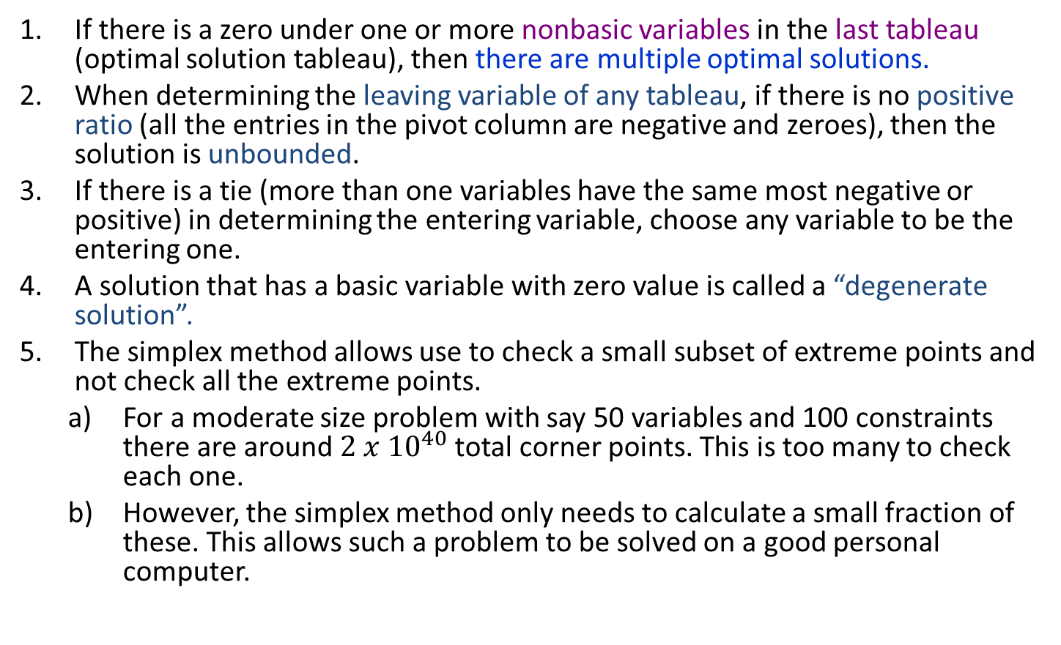
Simplex Method: Notes
If there is a zero under one or more nonbasic variables in the last tableau (optimal solution tableau), then there are multiple optimal solutions.
When determining the leaving variable of any tableau, if there is no positive ratio (all the entries in the pivot column are negative and zeroes), then the solution is unbounded.
If there is a tie (more than one variables have the same most negative or positive) in determining the entering variable, choose any variable to be the entering one.
A solution that has a basic variable with zero value is called a “degenerate solution”.
The simplex method allows use to check a small subset of extreme points and not check all the extreme points.
For a moderate size problem with say 50 variables and 100 constraints there are around $2 x {10}^{40}$total corner points. This is too many to check each one.
However, the simplex method only needs to calculate a small fraction of these. This allows such a problem to be solved on a good personal computer.

Slide 19
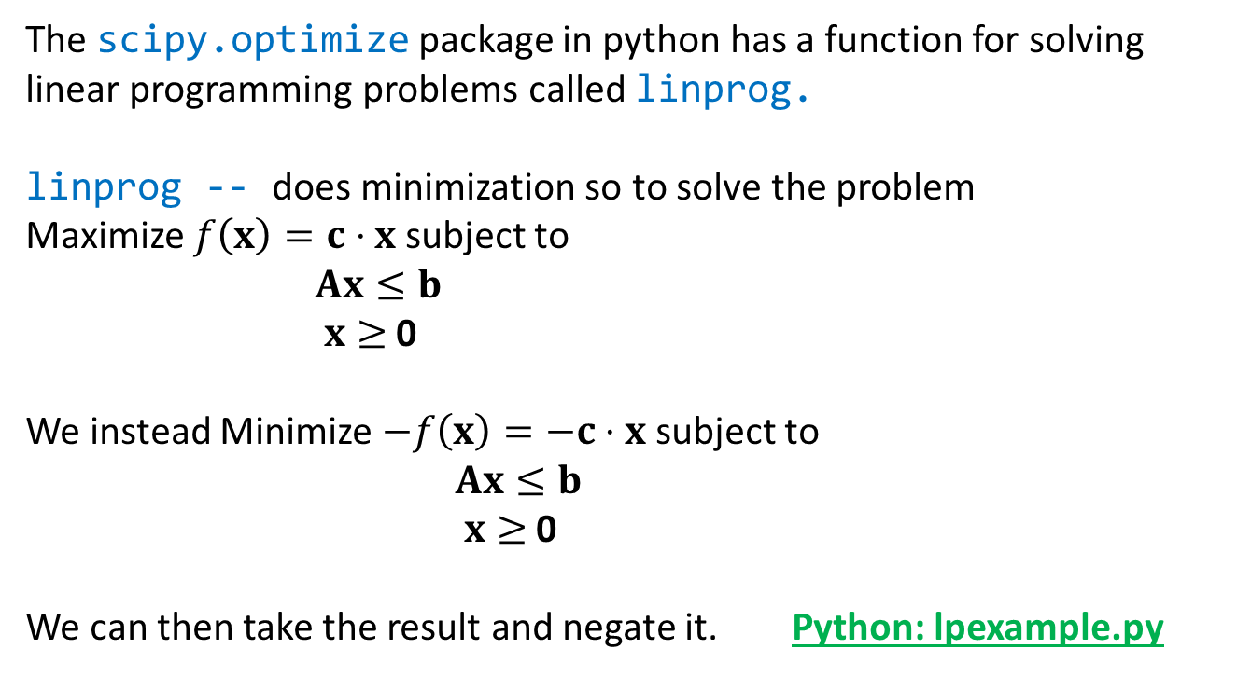
Simplex Method: Python
The scipy.optimize package in python has a function for solving linear programming problems called linprog.
linprog -- does minimization so to solve the problem Maximize $f\left(x\right)=c⋅x$ subject to
$Ax≤b$ $x≥$ 0
We instead Minimize $−f\left(x\right)=−c⋅x$ subject to
$Ax≤b$ $x≥$ 0
We can then take the result and negate it. Python: lpexample.py

Slide 20
Example: Solve with Python
Consider the example to the right.
We use c = [-3,-5] because we want to maximize (not minimize).
b = [4,12,18] is a list of upper bounds for the constraints
A = [[1,0], [0,2], [3,2]] is a 2d array representing the matrix for the constraints.

